Slide 1

LOVE IS A DATA FIELD
Sharon
Shai
Lara
2022

Slide 2
Dataset
A data set consisting of user profile data for 59,946 OkCupid users (a free online dating website) who were living within 25 miles of San Francisco from a period in the 2010s.
The data set includes typical user information (such as sex, sexual orientation, age, and ethnicity), lifestyle variables (such as diet, drinking habits, smoking habits) and text responses to 10 essays questions.

Slide 3
Essays Questions
“My Self Summary”
“What I’m doing with my life”
“I’m really good at”
“The first thing people usually notice about me”
“Favorite books, movies, show, music, and food”
“The six things I could never do without”
“I spend a lot of time thinking about”
“On a typical Friday night I am”
“The most private thing I am willing to admit”
“You should message me if…”

Slide 4
What does the San Francisco online dating landscape look like?
Demanding work schedules, long commutes, San Francisco men who suffer from Peter Pan syndrome, guys who don’t approach women offline and a shortage of women are some of the most commonly referenced reasons for such frustration among single folks in San Francisco.

Slide 5

Formatting and Cleaning Data
Convert height to meters, split city and state, take only the religion name
Find missing values
Height Analysis

Slide 6
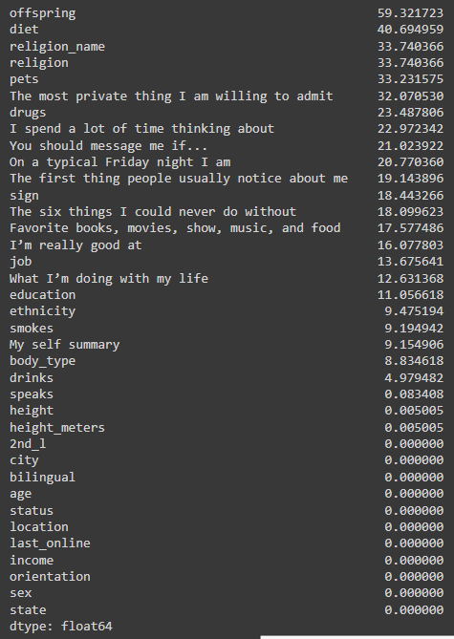
Find missing values

Slide 7
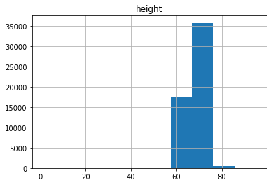
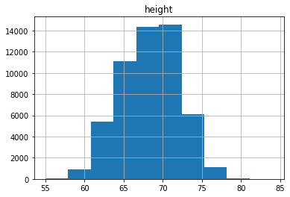
Height Analysis

Slide 8

Business Questions and Analysis

Slide 9
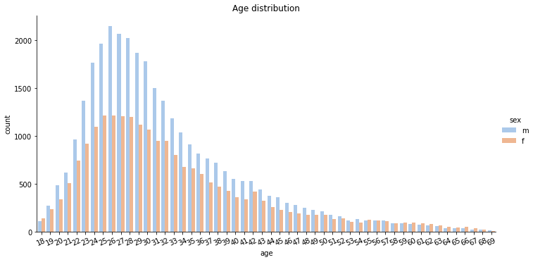
Age , sex and orientation
Hii SSL, we are a hip new night club for singles, can you please tell us about our target audience?
Most of the single male and female are between 24-30
you can see that the older they get its more even between the sexes
We also build HTML so the night club can go into more details about the target audience
Notes:
“There is in all things a pattern that is part of our universe. It has symmetry, elegance, and grace - those qualities you find always in that which the true artist captures. You can find it in the turning of the seasons, in the way sand trails along a ridge, in the branch clusters of the creosote bush or the pattern of its leaves.
We try to copy these patterns in our lives and our society, seeking the rhythms, the dances, the forms that comfort. Yet, it is possible to see peril in the finding of ultimate perfection. It is clear that the ultimate pattern contains its own fixity. In such perfection, all things move toward death.” ~ Dune (1965)

Slide 10
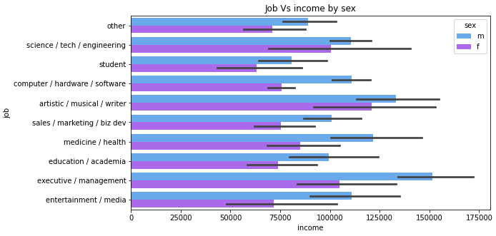
jobs
Hello, we are the state of california economy. We like to know about the average income for single’s and where are the most gap between men’s and women’s also if ethnicity is a factor?
Man in Executive and management make the most average income
And artistic are the most equal job between the sexes
Also build a interactive dashboard for ethnicity
Notes:
“There is in all things a pattern that is part of our universe. It has symmetry, elegance, and grace - those qualities you find always in that which the true artist captures. You can find it in the turning of the seasons, in the way sand trails along a ridge, in the branch clusters of the creosote bush or the pattern of its leaves.
We try to copy these patterns in our lives and our society, seeking the rhythms, the dances, the forms that comfort. Yet, it is possible to see peril in the finding of ultimate perfection. It is clear that the ultimate pattern contains its own fixity. In such perfection, all things move toward death.” ~ Dune (1965)

Slide 11
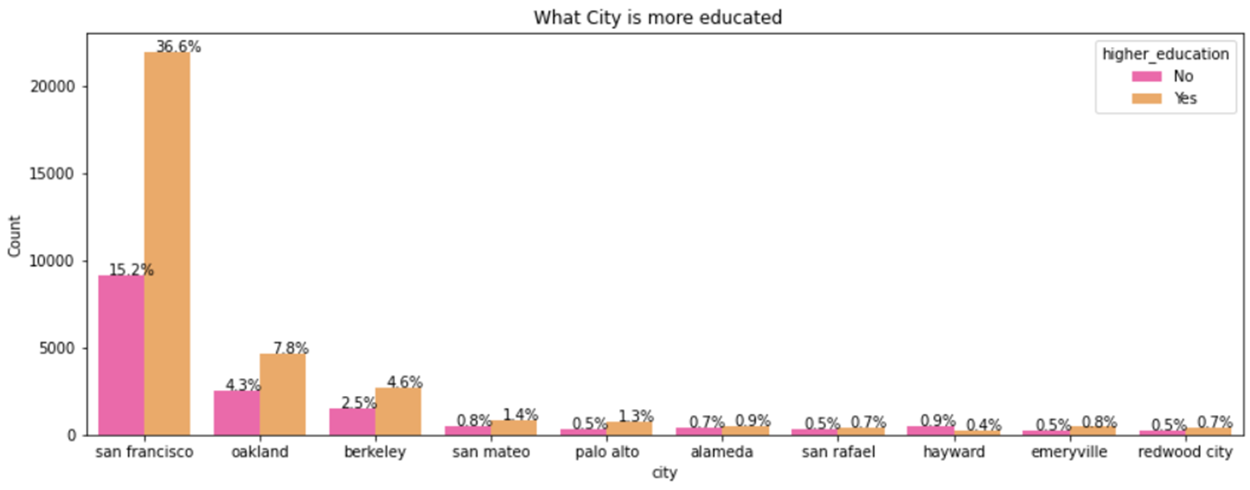
education
Hello, we are the state of california dept. of education. We like to know about the income of people with degree mean & std dev Vs people that didn’t study. also what is the most educated city in the bay area please
SF is the most education city in the bay (and also in the world :))
In the link a plot with all the summary data of income separated by education
Notes:
“There is in all things a pattern that is part of our universe. It has symmetry, elegance, and grace - those qualities you find always in that which the true artist captures. You can find it in the turning of the seasons, in the way sand trails along a ridge, in the branch clusters of the creosote bush or the pattern of its leaves.
We try to copy these patterns in our lives and our society, seeking the rhythms, the dances, the forms that comfort. Yet, it is possible to see peril in the finding of ultimate perfection. It is clear that the ultimate pattern contains its own fixity. In such perfection, all things move toward death.” ~ Dune (1965)

Slide 12
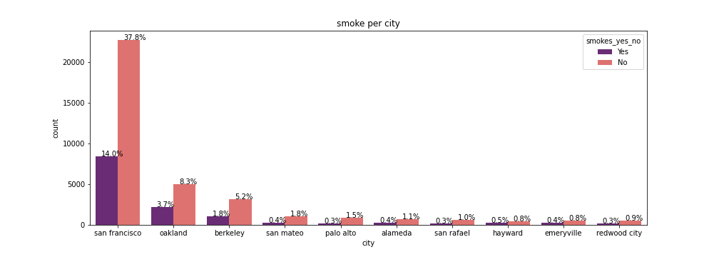
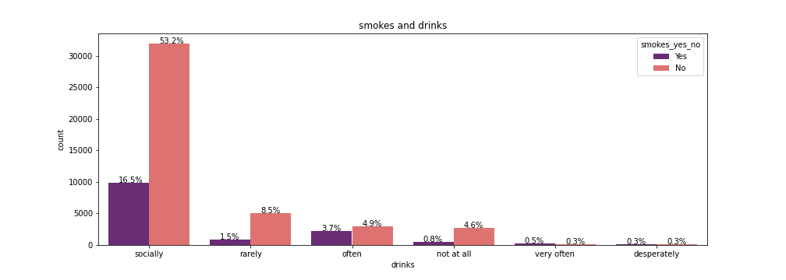
Smokes
Hello , We are the non-profit Smokes-Kills.
We are doing a new anti-smoke campaign an want to know where to put the ads and the target audience
Notes:
“There is in all things a pattern that is part of our universe. It has symmetry, elegance, and grace - those qualities you find always in that which the true artist captures. You can find it in the turning of the seasons, in the way sand trails along a ridge, in the branch clusters of the creosote bush or the pattern of its leaves.
We try to copy these patterns in our lives and our society, seeking the rhythms, the dances, the forms that comfort. Yet, it is possible to see peril in the finding of ultimate perfection. It is clear that the ultimate pattern contains its own fixity. In such perfection, all things move toward death.” ~ Dune (1965)

Slide 13
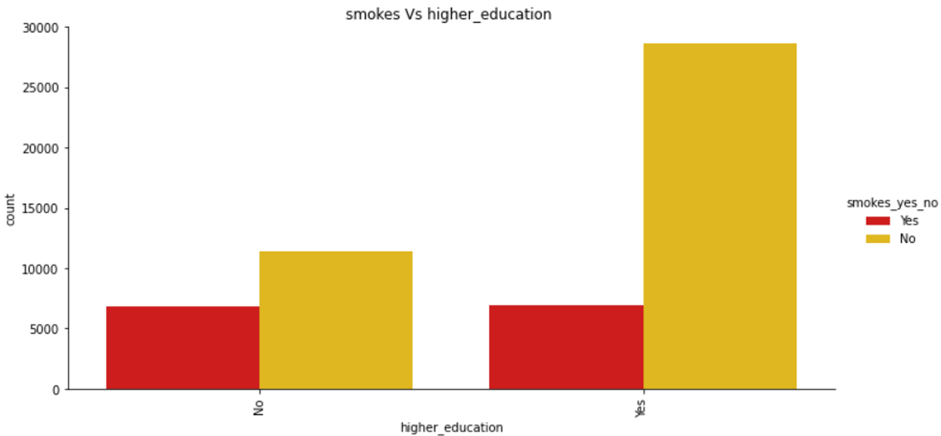
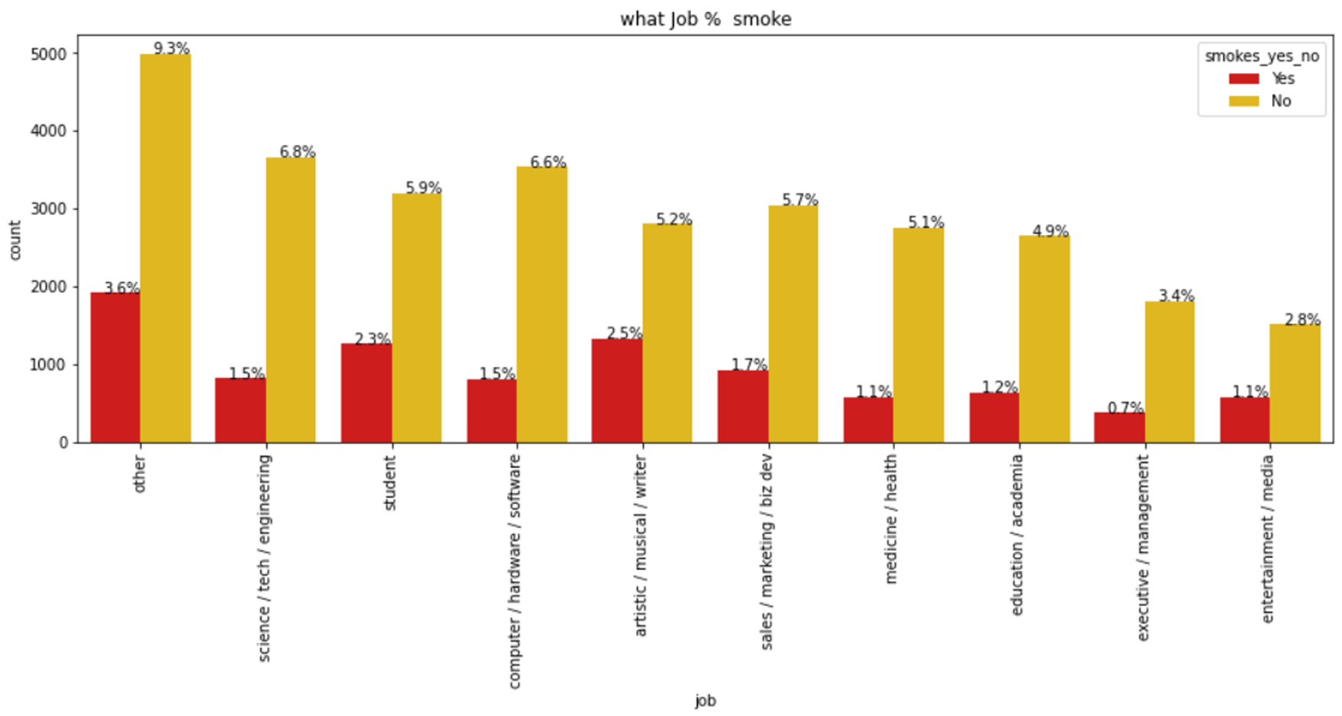
Smokes
From the plots you can see that SF have the most smokers and you should put the ad outside an artist Pub in blue color neighborhood
Notes:
“There is in all things a pattern that is part of our universe. It has symmetry, elegance, and grace - those qualities you find always in that which the true artist captures. You can find it in the turning of the seasons, in the way sand trails along a ridge, in the branch clusters of the creosote bush or the pattern of its leaves.
We try to copy these patterns in our lives and our society, seeking the rhythms, the dances, the forms that comfort. Yet, it is possible to see peril in the finding of ultimate perfection. It is clear that the ultimate pattern contains its own fixity. In such perfection, all things move toward death.” ~ Dune (1965)

Slide 14
Text Analysis

Slide 15
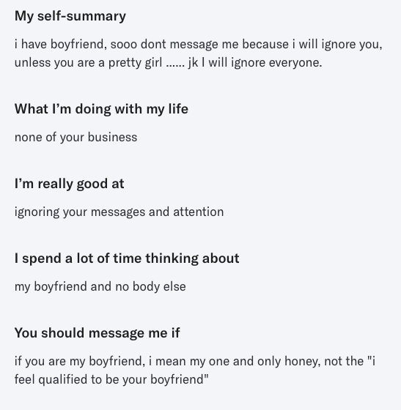
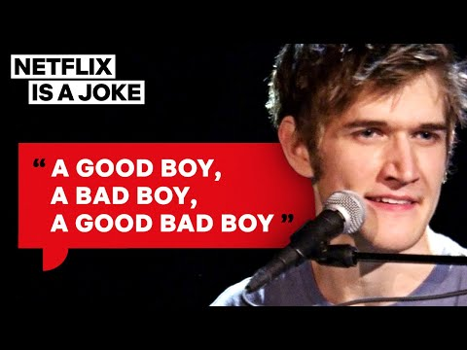
Text Analysis
10 introductory questions
unified text column
Profile users
Find Patterns
Find potential Matches
What do women want
Notes:
We performed text analysis using spaCy, a Natural language processing (NLP) framework.
spaCy’s has built-in statistical models, which enable to perform NLP related tasks, such as part-of-speech tagging, named entity recognition, and dependency parsing.
We used the en_core_web_lg: English multi-task CNN trained on OntoNotes, with GloVe vectors trained on Common Crawl.
In addition, we also combined all 10 questions' columns to 1 text column for a high level analysis of the text.

Slide 16
Effectively Pre-processing the Text Data: Text Cleaning
De-capitalization
Removing Unwanted Characters: numbers, emojis, punctuation, spaces
Removing Stopwords
Rare words removal
Lemmatization
Notes:
Normalize the text

Slide 17
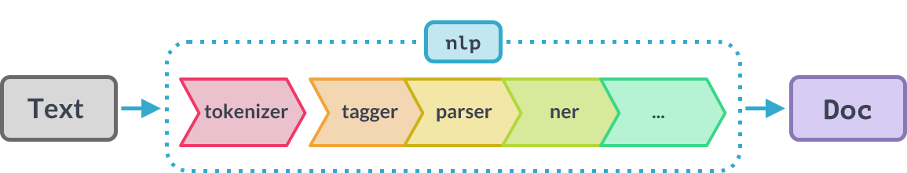
spaCy’s Processing Pipeline
Notes:
out of the box methods
When you call nlp on a text, spaCy first tokenizes the text to produce a Doc object. The Doc is then processed in several different steps – this is also referred to as the processing pipeline. The pipeline used by the trained pipelines typically include a tagger, a lemmatizer, a parser and an entity recognizer. Each pipeline component returns the processed Doc, which is then passed on to the next component.
The capabilities of a processing pipeline always depend on the components, their models and how they were trained. For example, a pipeline for named entity recognition needs to include a trained named entity recognizer component with a statistical model and weights that enable it to make predictions of entity labels.
The first step for a text string, when working with spaCy, is to pass it to an NLP object.
This object is essentially a pipeline of several text pre-processing operations through which the input text string has to go through.

Slide 18
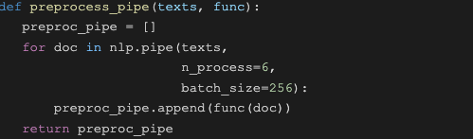
Processing Text
When processing large volumes of text, the statistical models are usually more efficient if you let them work on batches of texts.
spaCy’s nlp.pipe method takes an iterable of texts and yields processed Doc objects.
It process the texts as a stream and buffer them in batches, instead of one-by-one.
(Also, Multiprocessing.)
Notes:
We used the large trained model for the english language, en_core_web_lg which includes trained pipelines & weights - en_core_web_lg (trained word-vector)
set up an nlp object
create a doc object that is the processed version of the string input = a container of tokens
The tokens in a Doc object are Token objects, with a long list of attributes
When you call nlp on a text, spaCy will tokenize it and then call each component on the Doc, in order. It then returns the processed Doc that you can work with.
When processing large volumes of text, the statistical models are usually more efficient if you let them work on batches of texts. spaCy’s nlp.pipe method takes an iterable of texts and yields processed Doc objects. The batching is done internally.
N_process for multiprocessing
Process the texts as a stream using nlp.pipe and buffer them in batches, instead of one-by-one.
word2vec functions

Slide 19
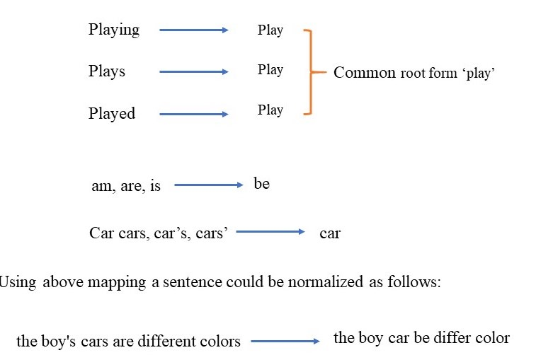
Lemmatization - Using spaCy’s attributes
Notes:
Lemmatization groups together words with the same root or lemma but with different inflections or derivatives of meaning so they can be analyzed as one item.
The aim is to take away inflectional suffixes and prefixes to bring out the word’s dictionary form.
Disclaimer - As the dataset was very large, we had to narrow it down to a sample of 10% of the data points in order for NLP efficient processing.

Slide 20
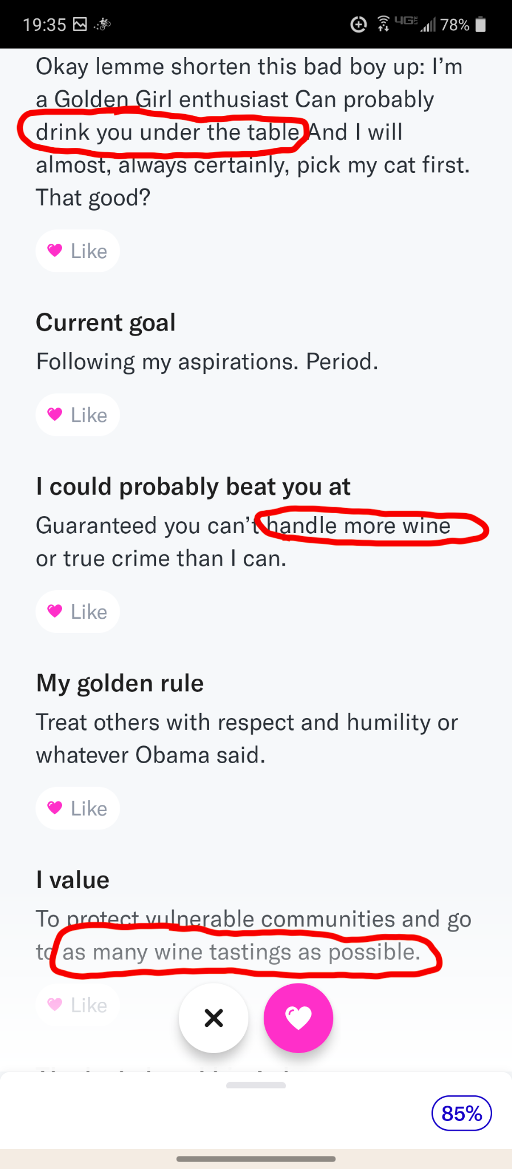
Look for the pattern…

Slide 21
Matcher - Rule-Based Matching using spaCy
We can look for a rule-based matching using the token attributes of spaCy’s objects:
pattern = [{"TEXT": "Alice"}, {"POS": "VERB"}]
pattern = [{"POS": "ADJ"}, {"POS": "NOUN"}]
pattern = [{"TEXT": "Alice"}, {"IS_PUNCT": True,"OP":"*"}]
Notes:
We can look for a rule-based matching using the token attributes of spaCy’s objects.
With the spaCy Matcher object, you can find words and phrases in the text using user-defined rules.
spaCy matcher uses the text patterns as well as the lexical properties of the word, such as POS tags, dependency tags, lemma, etc.
We tried to look for more specific patterns in the different answers according to the subject.
Breaking down the raw text into subject keyword can contribute to a more precise analysis of profiling and better matching.

Slide 22
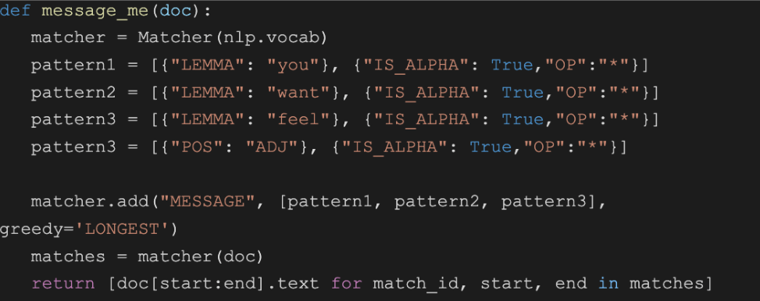
Match Text Patterns & Lexical Properties
spaCy matcher uses the text patterns as well as the lexical properties of the word, such as POS tags, dependency tags, lemma, etc.

Slide 23
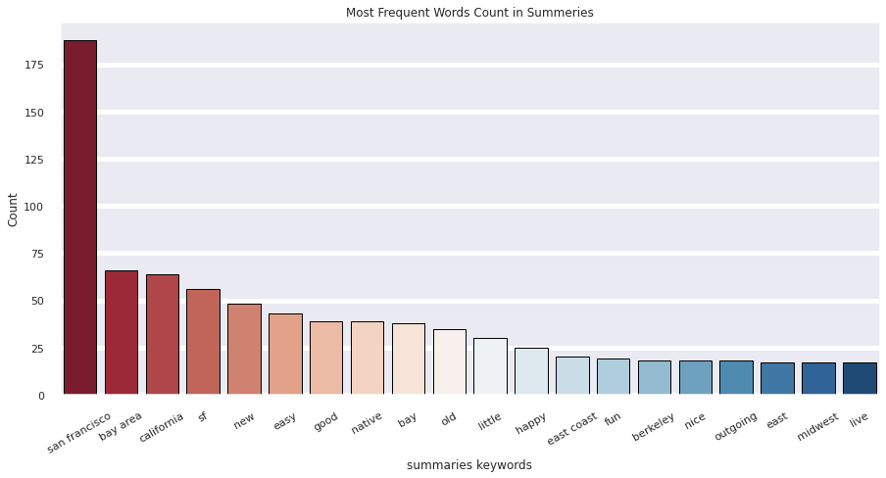
Most Frequent Words Count in Summaries
Notes:
The most frequent words people say about themselves are their geographic location which is trivial, but after that we can find:
easy, good, native, happy, fun, nice, outgoing.
People seem to be easy going and fun in the bay area, according to themselves.

Slide 24
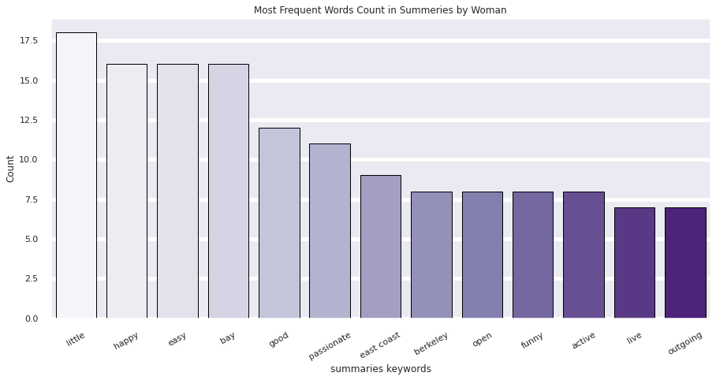
Most Frequent Words Count in Summaries by Woman
Notes:
The most frequent words women say about themselves are:
little, happy, easy, good, passionate, open, funny, active.
Women seem to be open to love & passion, with good intentions, happy with life and active (is it because everybody is fit in the valley?)

Slide 25
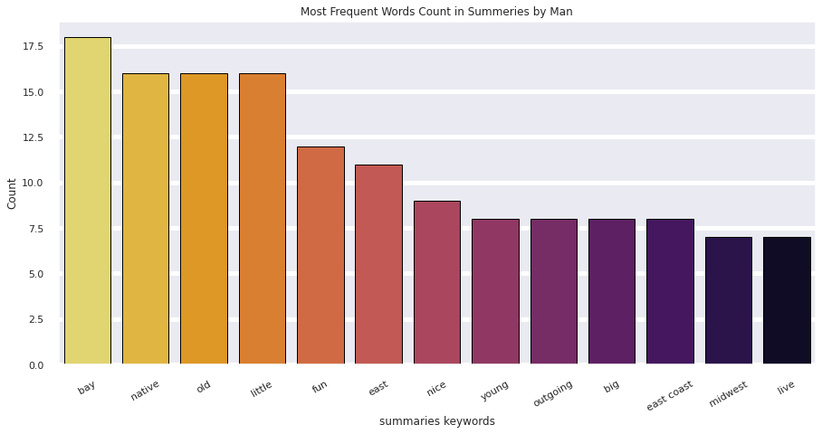
Most Frequent Words Count in Summaries by Man
Notes:
The most frequent words men say about themselves are: old, native, fun, nice, young, big, outgoing.
Men seem to be young and old (universities and lots of tech corporates in the area), nice, fun and outgoing is playing it safe.
Regarding big I don't know 🤷

Slide 26
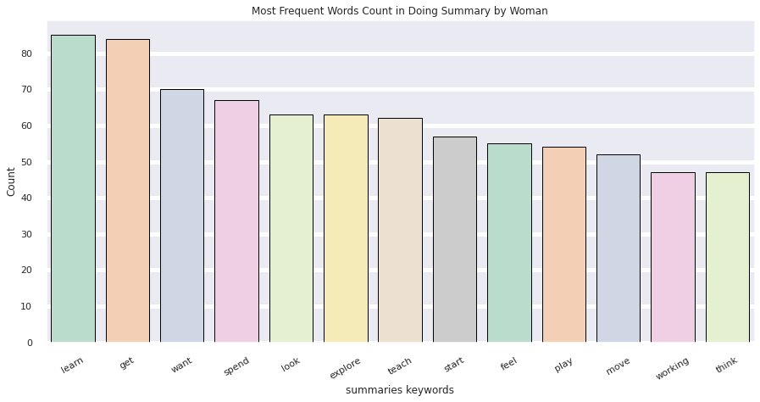
Most Frequent Words Count in Doing Summary by Woman
Notes:
The most frequent words women said they are doing in life:
learn, spend, look, explore, teach, feel, play, working, think. Women are smart as we know but again the bay area is full of universities so probably a lot of students.
Or engineers with money who can spend? I think the fact that working is not number one is a encouraging, as when identifying they don't see themselves as what they do necessarily.

Slide 27
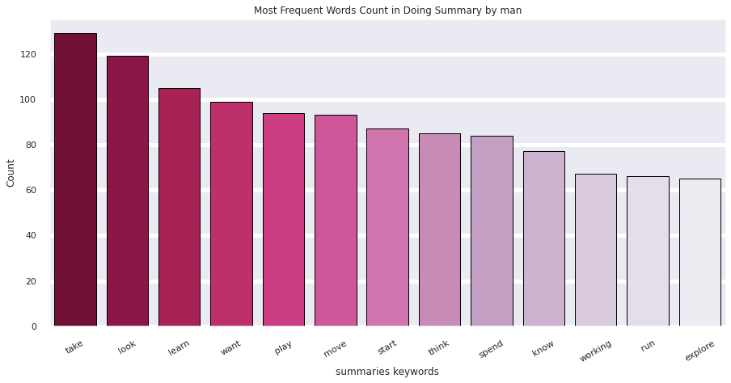
Most Frequent Words Count in Doing Summary by man
Notes:
The most frequent words men said they are doing in life:
take, look, learn, want, play, know, explore, move, start.
Perhaps they are looking for their next challenge, start their own startup, and run and move of course, cause it's an overrated fitness culture overthere.

Slide 28
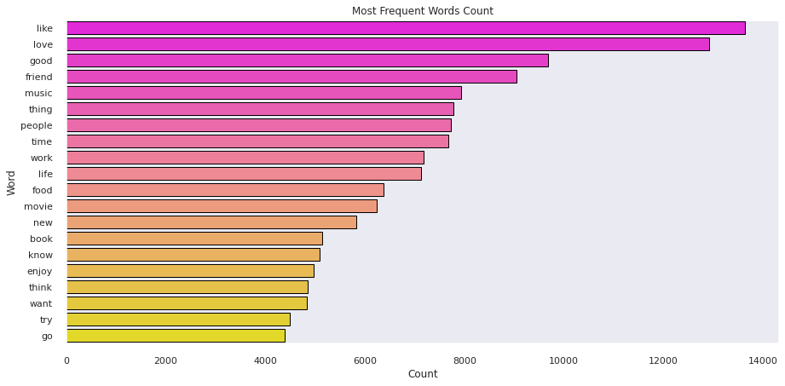
Most Frequent Words Count
Notes:
Out of the total words, the words with the highest counts are:
like, love, good, friend, music, people, time, work.
Not surprising giving it is a dating app so you might repeat what you wish the most.

Slide 29
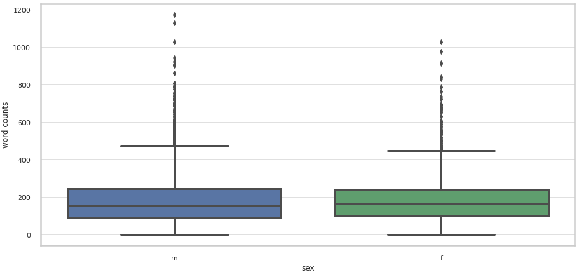
Who talks more about himself?
Notes:
Median is slightly higher for women but some men like to write much more… (outliers)

Slide 30
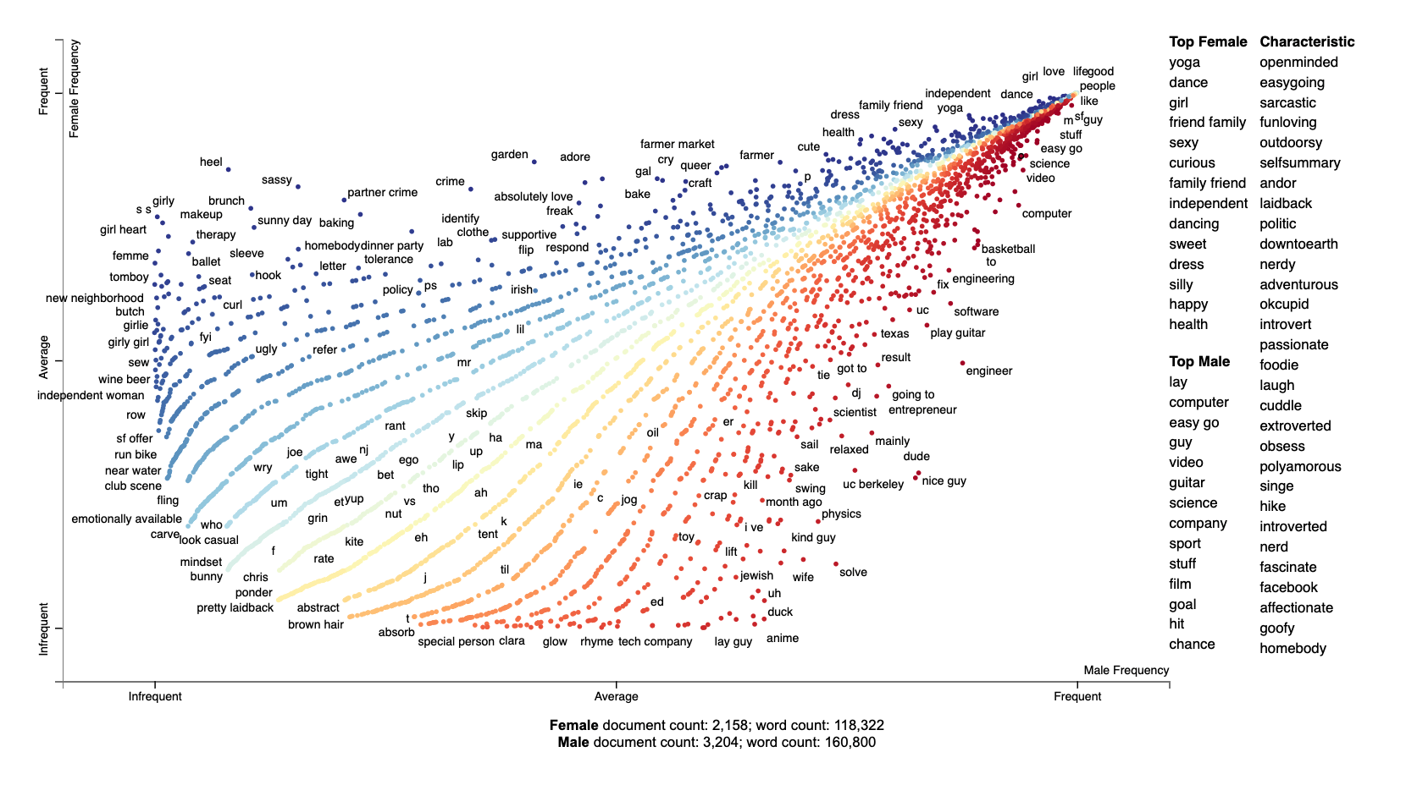
What women & men are saying about themselves:
Notes:
scattertext- Visualizing Term Associations
Scattertext is a tool that’s intended for visualizing what words and phrases are more characteristic of a category than others.
Scattertext uses scaled f-score, which takes into account the category-specific precision and term frequency.
While a term may appear frequently in both categories (males & females), the scaled f-score determines whether the term is more characteristic of a category than others (males or females).
On the right side of the scatter plot, we have an overview of top terms and an unordered list of terms under characteristic.
The red dots on the right side of the plot indicate terms that are more associated with males while blue dots on the left side indicate terms that are more associated with females.
The middle line will be the equally shared words for both sexes.
In this case as you go toward the top-right of the chart you will find the most frequent of the most-shared terms and the bottom-left is where you will find the least frequent of the most-shared terms.

Slide 31
Frequent words to both sexes (middle line)
Male:
“humble easygoing sarcastic tattooed entrepreneur value honesty humor nice smile ptetty ladyy”
passionate singersongwriter funkyass dancer
nerd like science science fiction anime video game type game comic strip late night tv read internet geeky
Female:
“proudly nerdy sarcastic generally happy person”
welsh woman passionate hard music irish whiske
study computer science grad school work startup company software engineer

Slide 32
What women & men are looking for:

Slide 33
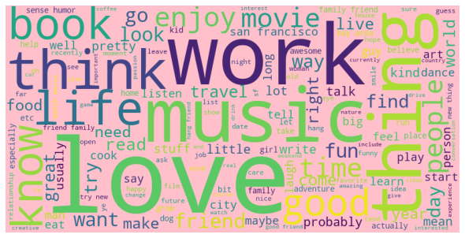
Most frequent words in unified text
WordCloud
Notes:
In a Word Cloud different sizes represent the frequency or the importance of each word.
Also called Tag Cloud.

Slide 34
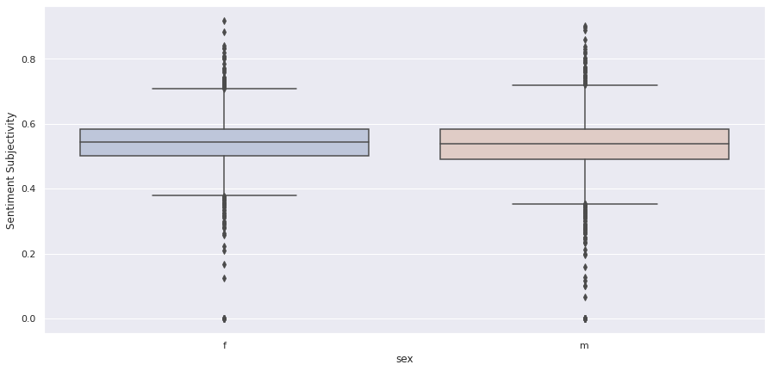
Sentiment Analysis using TextBlob
Sentiment Subjectivity
Notes:
Sentiment Subjectivity computed by sex. Shows females tend to be a little more personal in their writings, but not in a distinctive difference.
determine the intent of the person
the challenge here is that same intent can be conveyed in very different ways.
semantic similarity can play a big role in text processing like for intent classification
TextBlob is a python library for NLP which uses the NLTK package to access its lexical resources.
For lexicon-based approaches, a sentiment is defined by its semantic orientation and the intensity of each word in the sentence.
This requires a pre-defined dictionary classifying negative and positive words.
After assigning individual scores to all the words, final sentiment is calculated.
TextBlob returns polarity and subjectivity of a sentence.
Subjectivity lies between [0,1].
Subjectivity quantifies the amount of personal opinion and factual information contained in the text.
The higher subjectivity means that the text contains personal opinion rather than factual information.

Slide 35
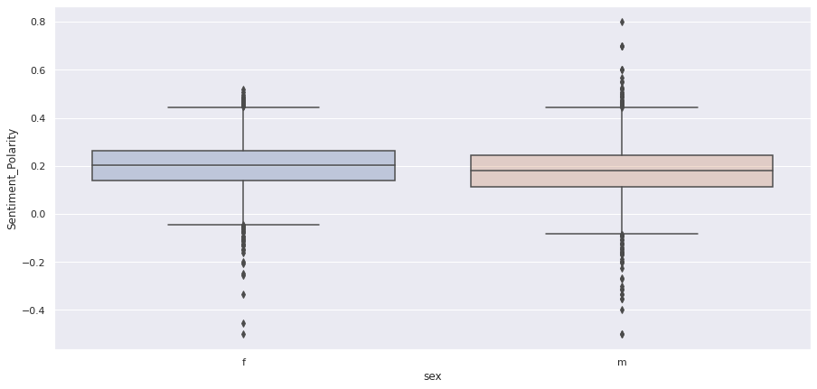
Sentiment Polarity
Notes:
Polarity: [-1,1] (-1 negative sentiment) (1 positive sentiment)
-1 defines a negative sentiment and 1 defines a positive sentiment.
We can see for women slighly higher median polarity but with a very distinct tail towards the negative sentiment.
While at the men we can also see such negative sentiment, there is also a positive one as well, greater the in the women.
This can indicate a little more positive sentiment in their profiles.

Slide 36
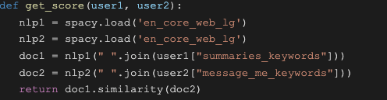
Word Embedding / Similarity
The similarity function in spaCy is by default calculated as cosine similarity, with vectors averaged over the document for missing words.
We implemented a find_matcher to find the matching score between a user and 4 potential matches according to their preferences.
Notes:
0 - 1 score
Word vectors and semantic similarity
Similarity is determined by comparing word vectors or “word embeddings”, multi-dimensional meaning representations of a word. Word vectors can be generated using an algorithm like word2vec
By default it's cosine similarity, with vectors averaged over the document for missing words.
return numpy.dot(self.vector, other.vector) / (self.vector_norm * other.vector_norm)
We tried to implement a function to find best matches for a user according to his/her preferences and sex.

Slide 37

Next Project - Hack the App using ML…
💖💖💖💖💖💖💖💖💖💖
💖💖💖 Thank you

Slide 38

Notes:
2nd part of the presentation, text analysis using spaCy- a free, open-source library for advanced Natural Language Processing (NLP) in Python.

